Slide 1

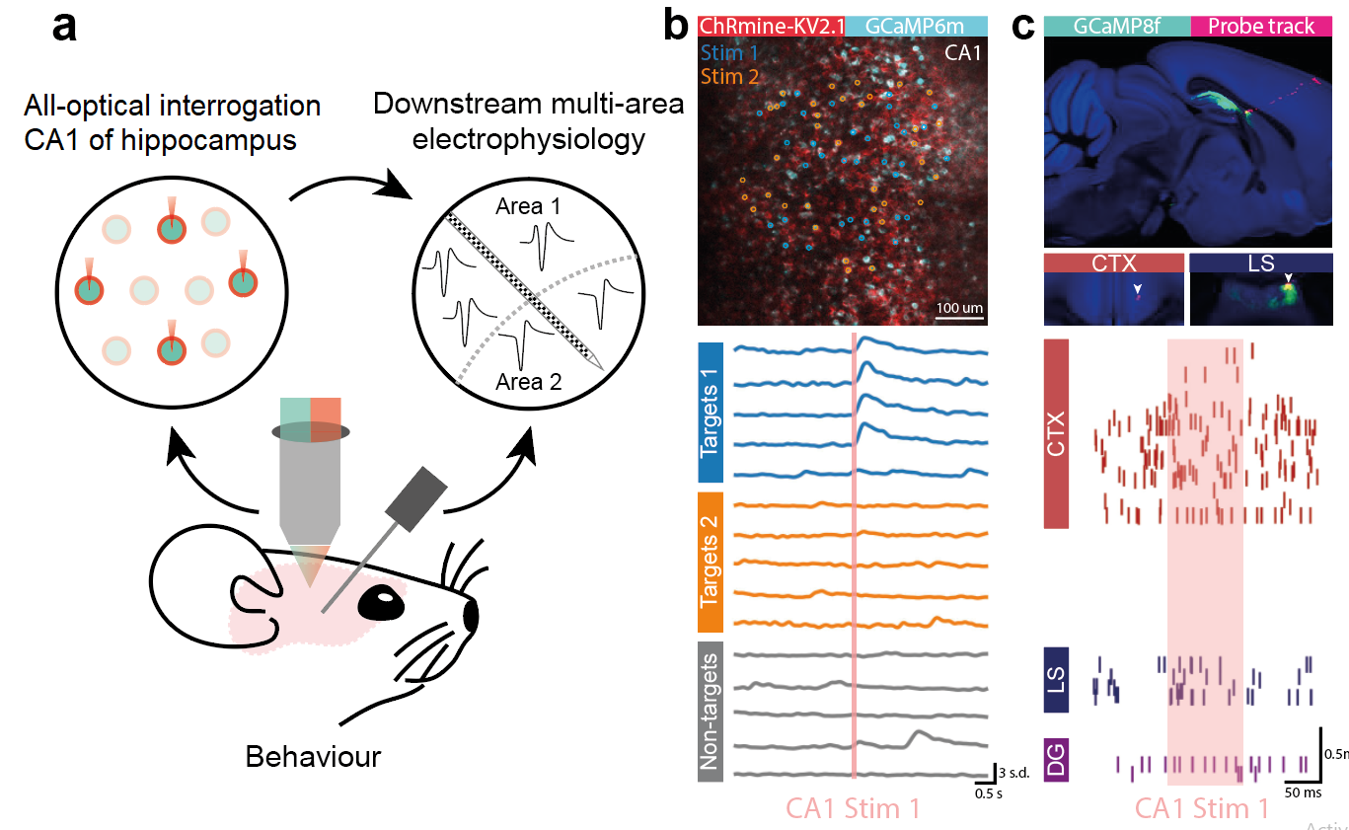
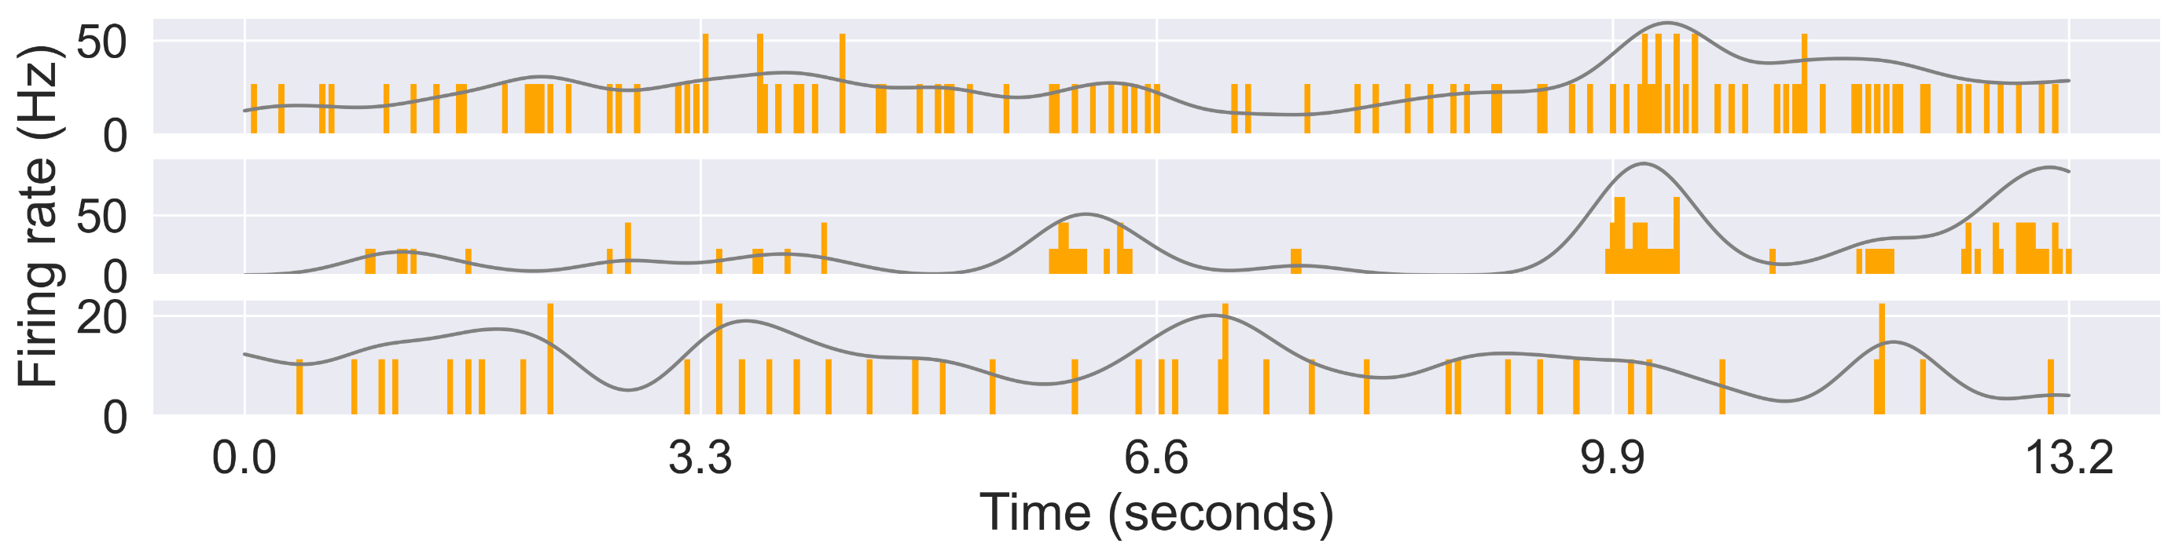
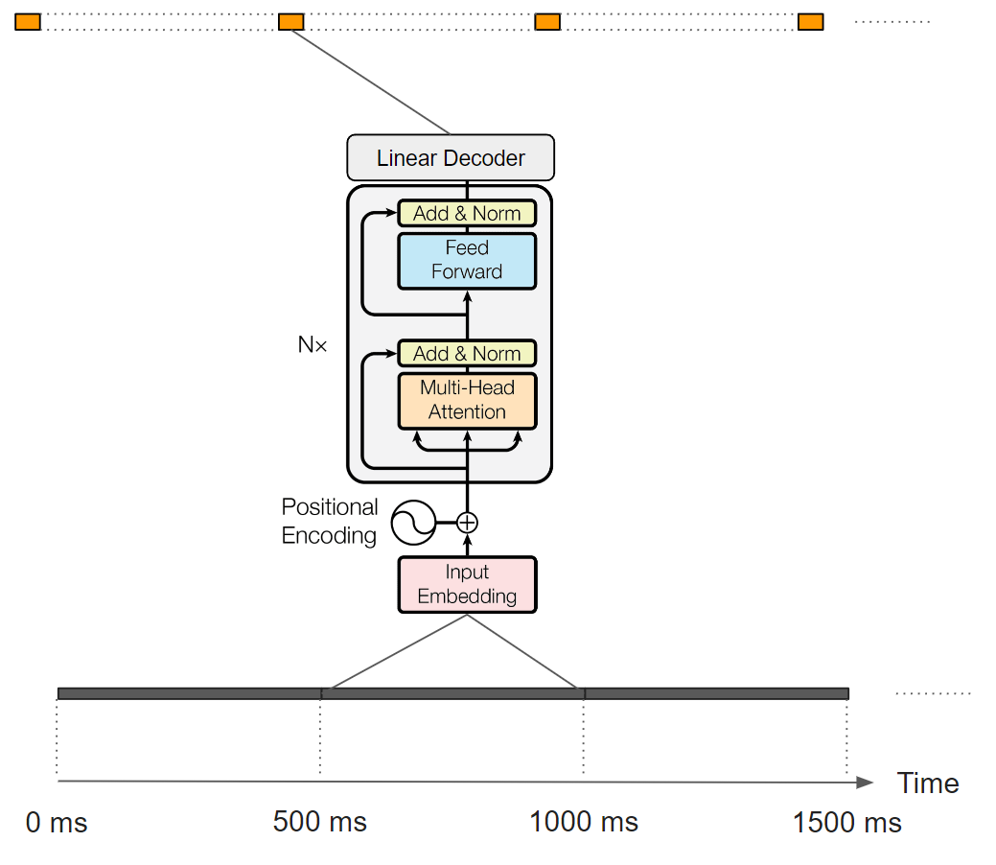
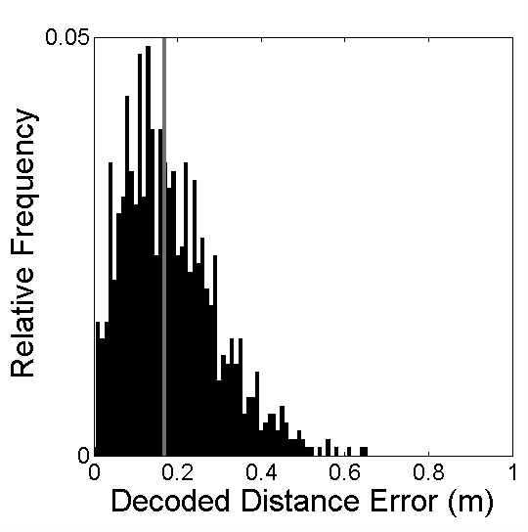
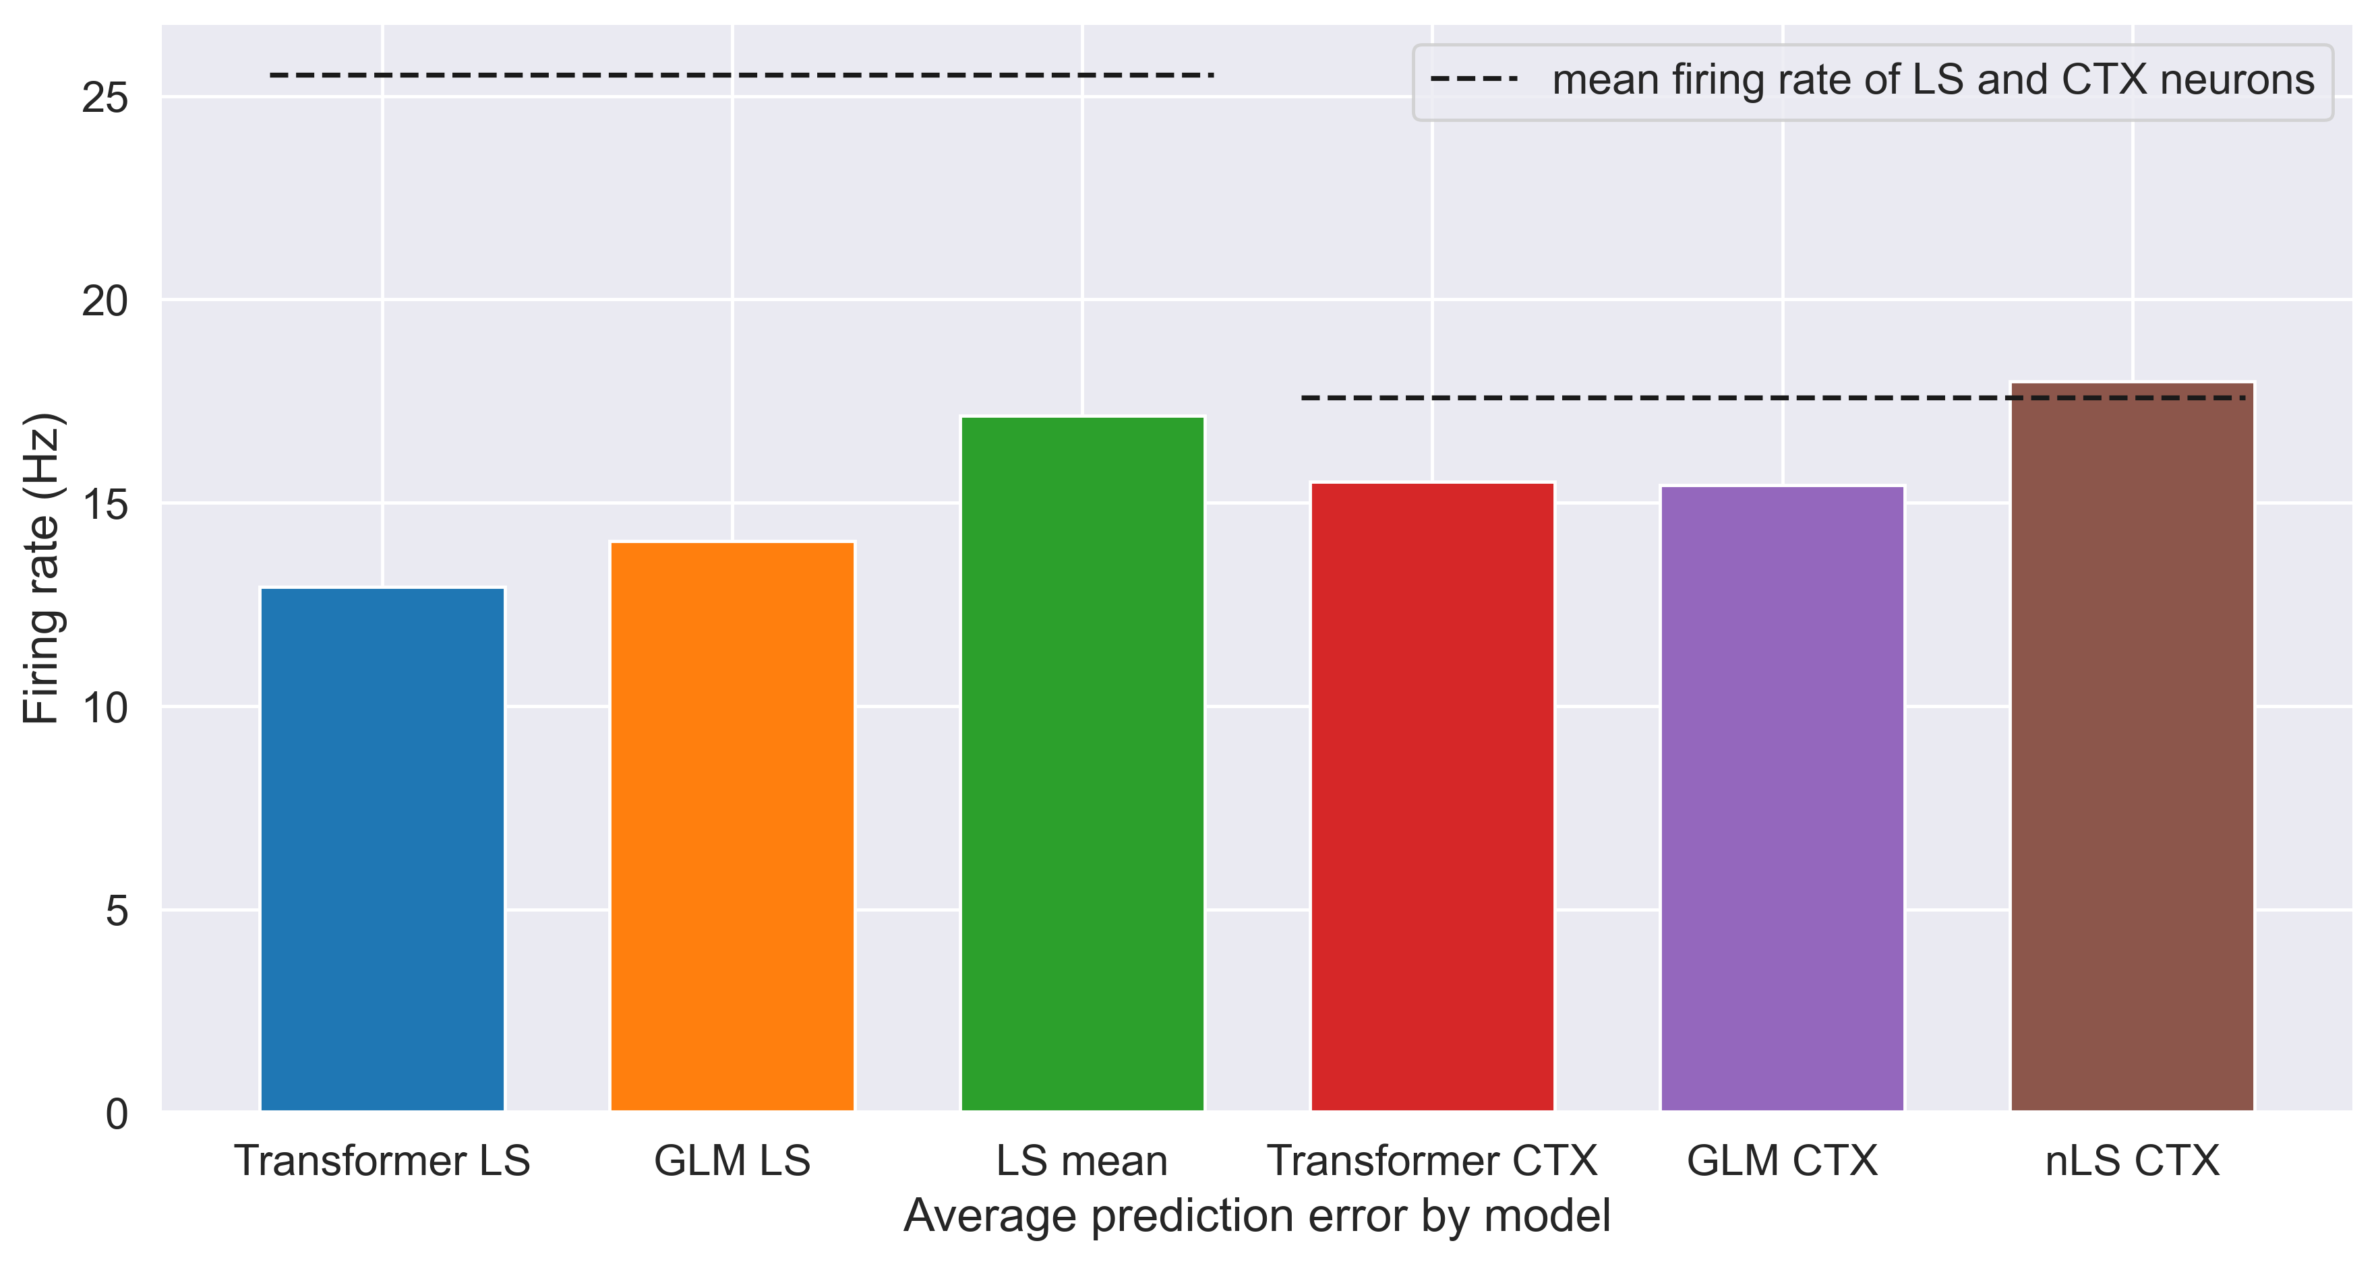
Transformer Learns Neural Circuit with Diverse Stimulation Patterns
S. Liu^{1*}; A. Mavor-Parker^{2,3*}; E. Baumler; M. Buchholz & C.Barry¹
¹ UCL Dept of Cell & Developmental Biology. ² UCL Inst yyy. ³ UCL Inst of xxx. * Equal contribution. Correspondence to first.author@ucl.ac.uk or caswell.barry@ucl.ac.uk
To understand the brain, we need to understand the computations performed by neural circuits. One approach is to use observed data to distil the neural function into artificial neural networks.
We simultaneously performed all-optical and Neuropixel recordings in two brain areas… We then trained Transformer neural networks on the data pairs.
Simultaneous neural recordings
Stimuli injection
CA1
CTX
CTX
LS
GCaMP signals in hippocampus CA1
Multi-unit spiking activities in the lateral septum (LS) and neocortex, smoothened at 330 ms
Numerous neural implementations are possible
Transformer learns endogenous activities
1. Distance cell model
Instantaneous
spiking rates
Transformer
Encoder
‘Distance cells’ encode displacements d_{x} along a single axis. Each distance cell receives input from grid cells of all modules proportional to their firing rate at that position on the axis. Distance cells provide input to a single read-out cell with weights proportional to distance along the axis. Start and Goal locations are compared using two arrays of distance cells opposingly connected to two read-out cells⁵.
Fluorescence
signals
2. Linear look ahead model
Velocity input is decoupled from self-motion, the represented position sweeps away from Start². The firing rate of a cell that integrates activity in the network encodes dx when grid cells representing Goal are simultaneously active in each module. 2D vectors are handled with sweeps along two non-collinear axes, in which grid cells that share a phase on each axis in each module are simultaneously active
Conclusions
¹Hafting et al (2005) Microstructure of a spatial map in the entorhinal cortex. Nature 436, 801-806. ²Fiete et al (2008) What Grid Cells Convey about Rat Location. J Neurosci 28, 6858-71. ²Kubie & Fenton (2012) Linear Look-ahead in Conjunctive Cells: An Entorhinal Mechanism for Vector-Based Navigation. Front. Neural Circuits doi: 10.3389. ⁴Orchard et al (2013) Does the entorhinal cortex use the Fourier transform? Front Comp Neurosci 7:179. ⁵Chen & Verguts (2010) Beyond the mental number line: A neural network model of number-space interactions. Cogn Psychol 60:218-240.

